Slide 1
Welcome to 6th Grade
Be a KEE Night

Slide 2
Executive Principal
Mr. Norris
anthony.norris@knoxschools.org

Slide 3
6th Grade Assistant Principal
Mr. Labig
mark.labig@knoxschools.org

Slide 4
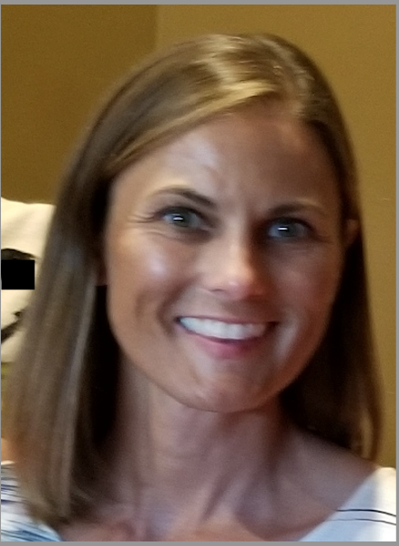
6th Grade Assistant Principal
Dr. Johnson
Collaborate with teachers to enhance teaching and
learning opportunities
Assist in maintaining a safe learning environment
Coordinate after school tutoring opportunities
tonia.johnson@knoxschools.org

Slide 5
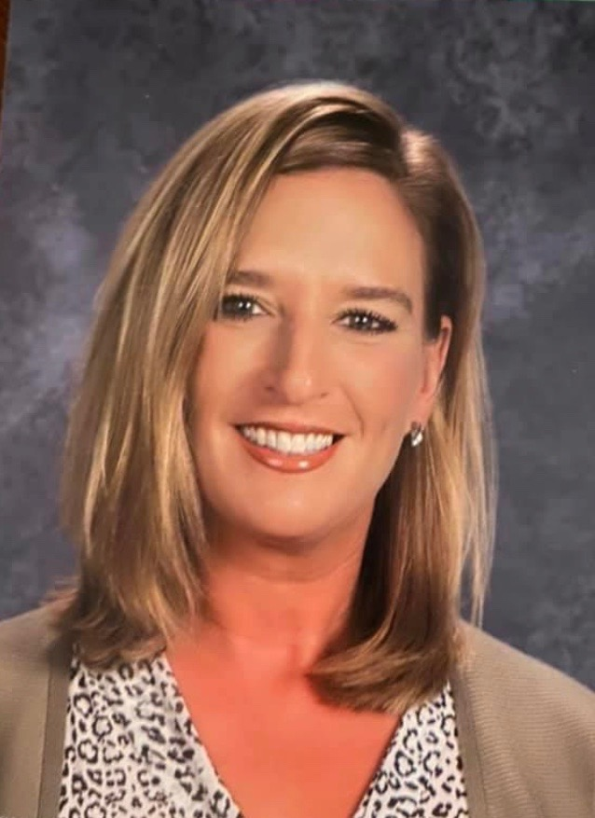
School Counselor
Ms. Wellner
Social and emotional support
Meets with students individually and in groups
Assists students with behavior and conflict issues
If you need help or questions answered,
Ms. Wellner can help you!
jessica.wellner@knoxschools.org

Slide 6
Toby the H.A.B.I.T dog

Slide 7
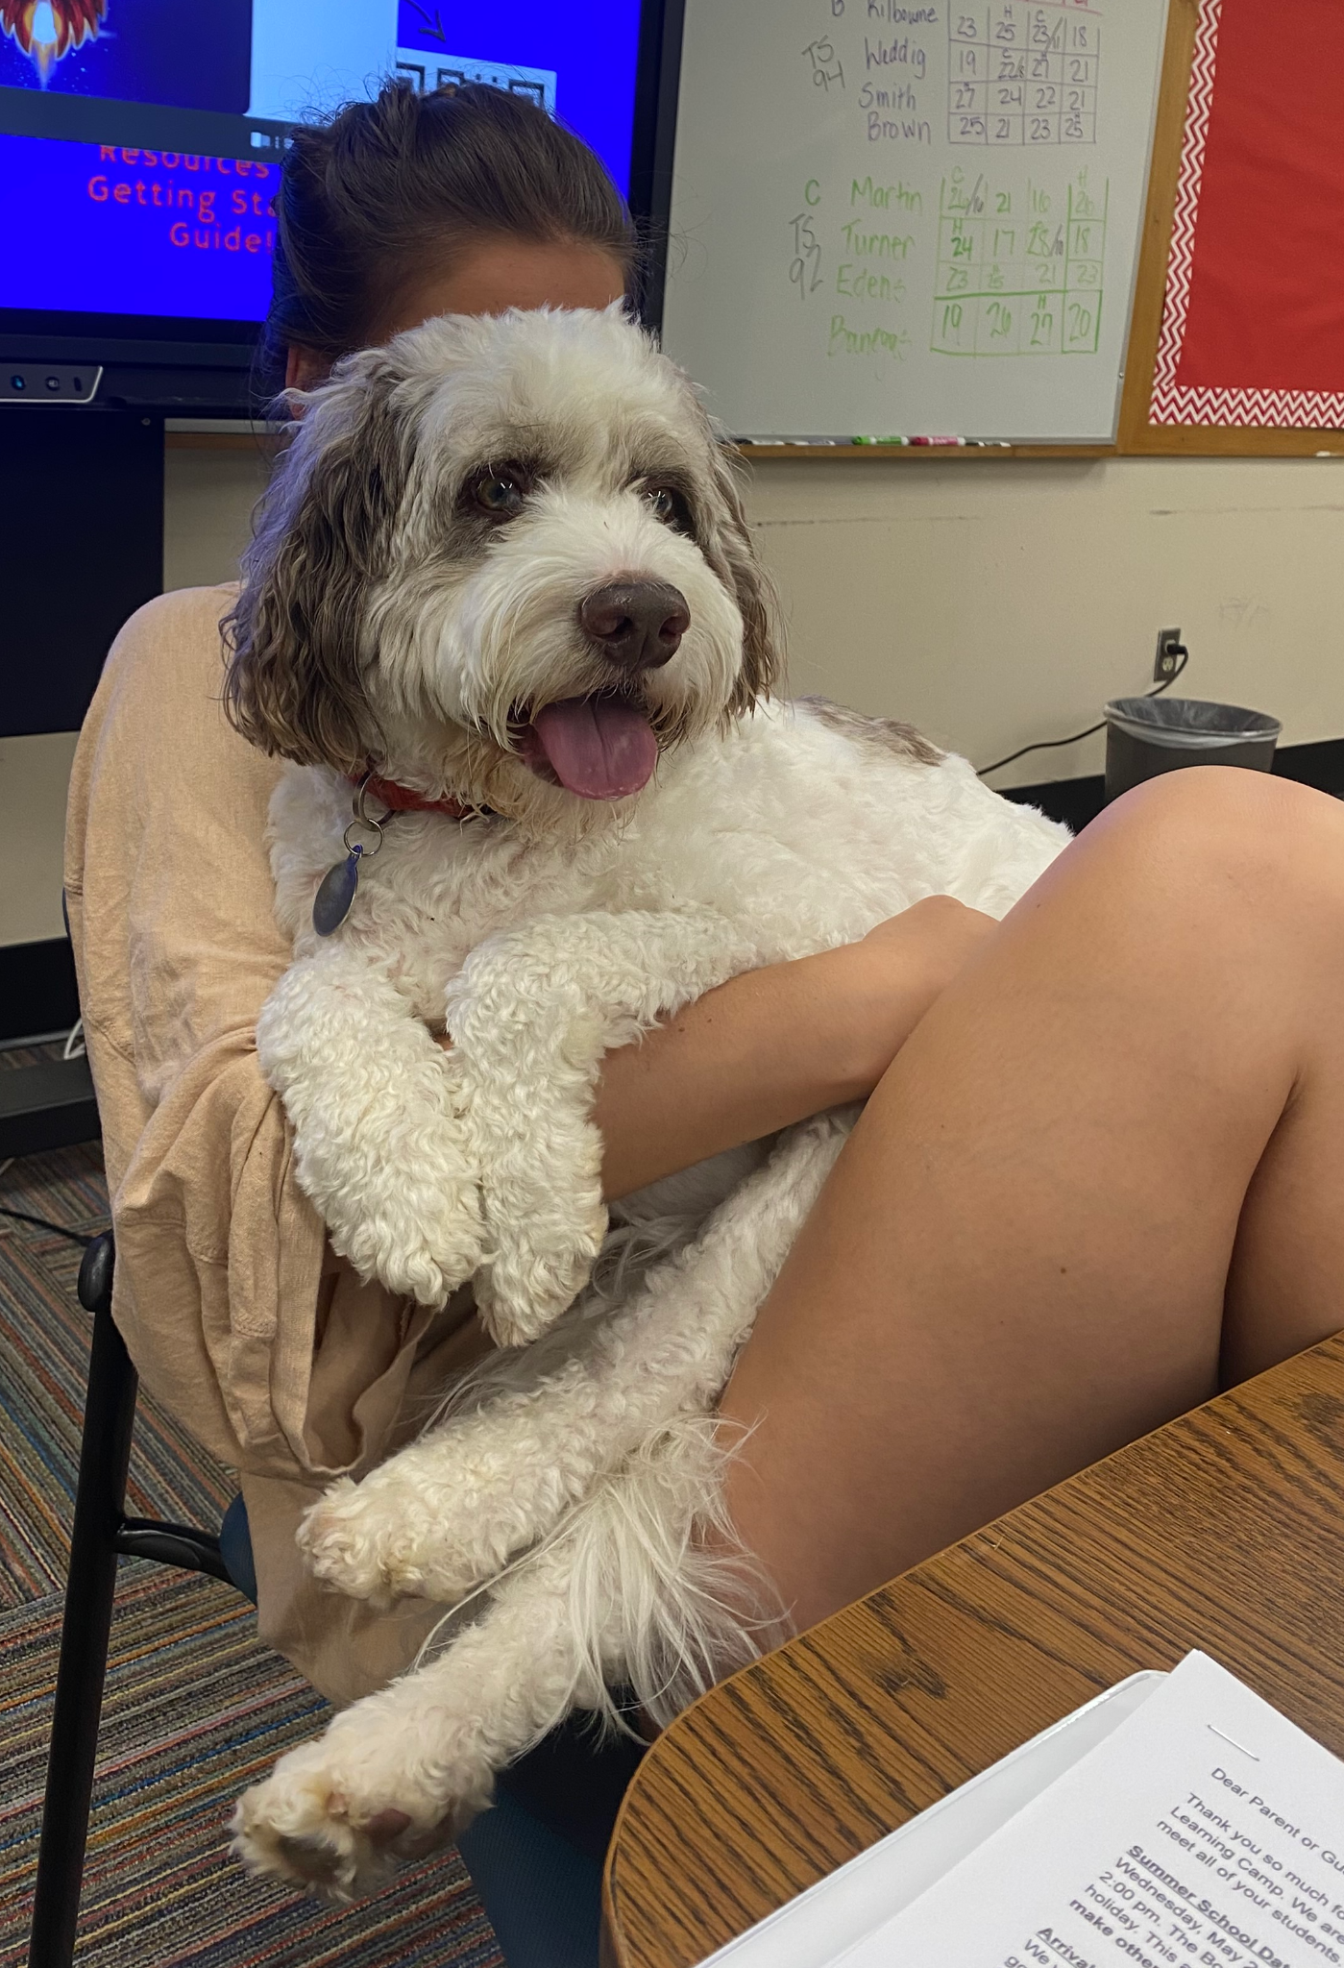
TOBY’S EXPECTATIONS
Approach Toby slowly with empty hands, and please ask permission to him. Please wait for an answer.
If you are given permission to pet Toby, please pet him somewhere other than the top his head.
Stand next to Toby on his side, not directly in front of him.
Extend a hand palm down so Toby can sniff you if he wants to.
Don’t jerk you hand away if he licks you, he might think your playing with him.
PLEASE DO NOT feed Toby any human food, he has a very sensitive stomach.
Please do not give Toby any commands.

Slide 8
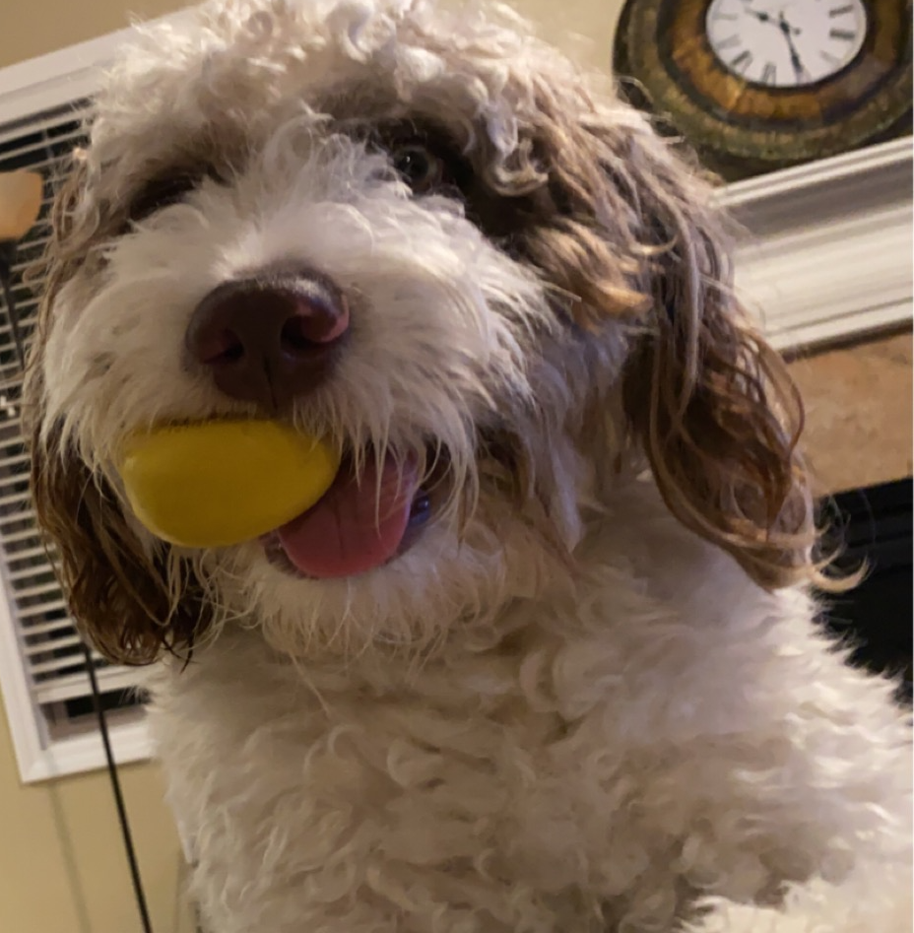
Facts about Toby
Toby is a miniature Saint Bernard Poodle mix
Toby is playful
Toby has lots of energy
Toby is very protective of myself and my two children
Toby has a favorite toy called his passsie. Toby likes to squeak it. Please do not take it away from him.

Slide 9
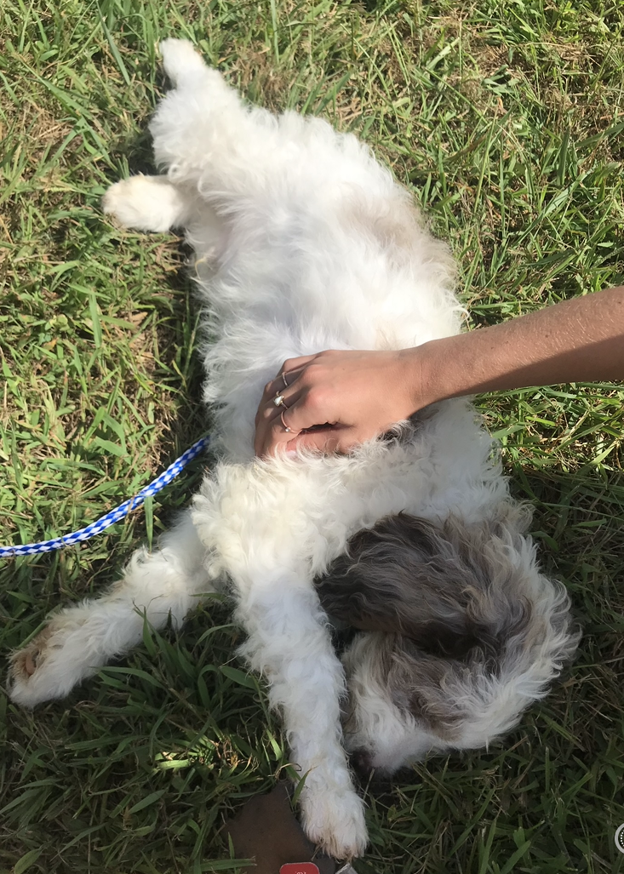

Slide 10
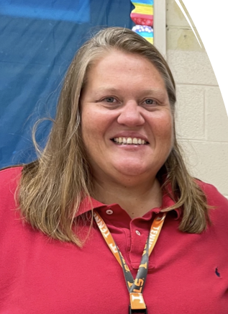
Behavioral Support
Ms. Welch
Conflict resolution and mediation
Individual student conferencing
Behavior support strategies
Self-regulation strategies
Behavior agreements

Slide 11
Arriving at School
7:30 AM Doors open*
7:30 - 8:00 AM Students in gym
8:10 AM Students released to breakfast; take to homeroom
8:25 AM Morning Announcements
8:30 AM KEE Time
8:50 AM 1st Period Begins**
*Students may not be dropped off at SDMS before 7:30 AM
**Students arriving after 8:30 AM will need to check in at the front office and bring late slip to teacher

Slide 12
6th Grade Daily Schedule
8:30 - 8:45 KEE Time
8:50 - 10:00 1st Period
10:00 - 11:10 2nd Period
11:10 - 12:00 3rd Period
12:00 - 12:30 Lunch
12:30 - 12:55 3rd Period (cont.)
12:55 - 2:00 4th Period
2:00 - 3:30 5th Period Related Arts

Slide 13
Leaving School
3:25 PM Afternoon Announcements + Walkers Dismissed
3:30 PM Bus Riders Dismissed
3:35 PM Car Riders Dismissed
*Car Riders enter the parking lot and locate cars on their own
Note: Clubs and tutoring require parental transportation home

Slide 14
Communication
At SDMS we value communication - we WANT to hear from you and welcome meeting with you. You are the most important partner we have.
Ways you can communicate with SDMS teachers and administrators:
Parent Square
Email
Phone call
Scheduling an in-person meeting

Slide 15
Communication (continued)
Parent Square App
We use parent square to communicate school-wide announcements, contact parents individually, and communicate behavior agreements, progress, etc.
Aspen Parent Accounts
This will allow you to check your students’ grades and schedule in real time.
For help with Aspen, contact KCS Help Desk online.
Email
Please make sure that you have an email account listed in Aspen.
Phone calls
Please provide the front desk with accurate and up-to-date phone numbers. This is a safety issue as well as a communication necessity.

Slide 16
Behavior + Intervention
It is our role to help our 6th graders learn the expectations at SDMS and reinforce the behaviors that are appropriate at SDMS.
6th graders are, for the first time, making more adult(ish) decisions and don’t fully understand the adult consequences.
Middle schoolers are navigating 3 sets of Rules:
Societal Rules
Home Rules
School Rules
Please understand that home rules and school rules sometimes conflict and that students are held to the expectations of school rules while at school - even if they are not the same as rules at home.
Discipline is progressive and follows KCS J-191 Board Policy for Misbehaviors and Disciplinary Options

Slide 17
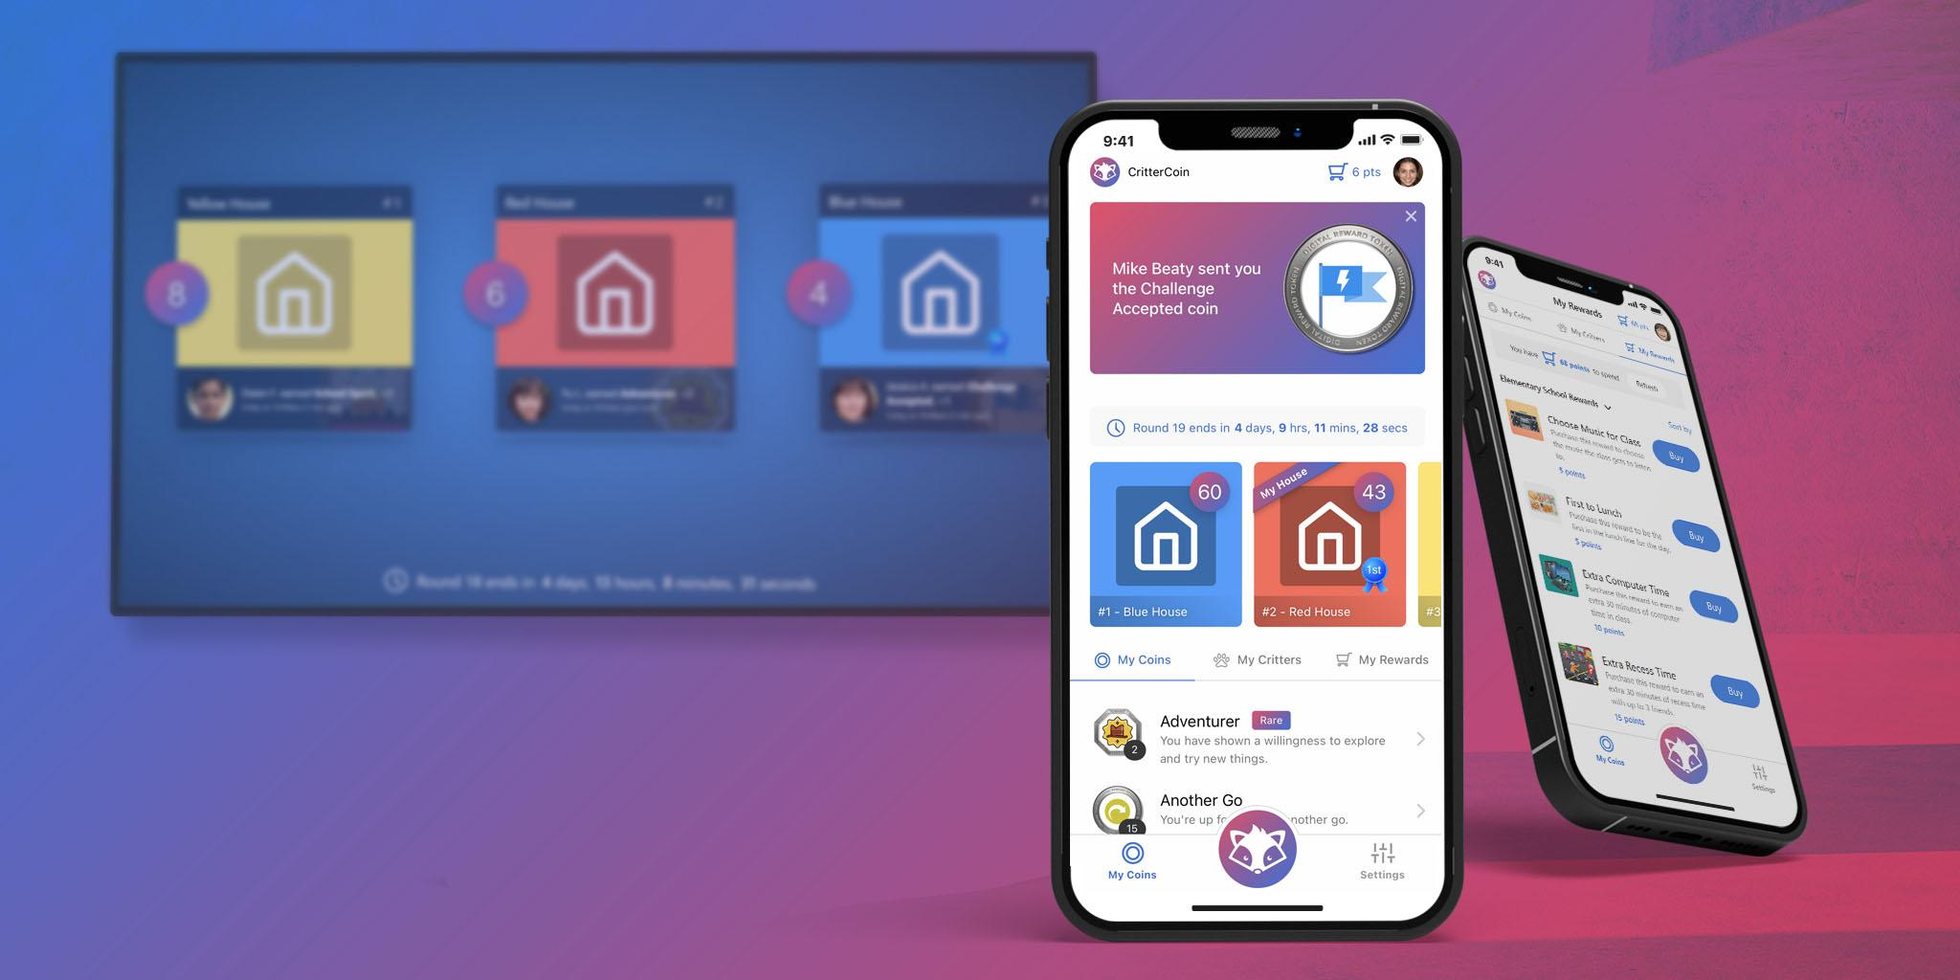
Behavior + Intervention
Teachers
Restorative Interventionists
Counselor
Administrators
Behavior Agreements
Positive Behavior Incentives: KEE Coins
RLC vs ATS

Slide 18
Minor Log + Aspen Referrals
Minor Log
Parent receives email notification
Behaviors and interventions are linked to the referring teacher
Resets at the semester

Slide 19
Minor Log + Aspen Referrals
Conference with teacher (review expectations)
Restorative questions with teacher and parent contact (attempt documented)
Refer to restorative team to complete a restorative/reflection sheet, teacher contact parent (attempt documented)
Refer to restorative team, student completes behavior think sheet and develops action plan with restorative team, share action plan with teacher and grade level administrator
Aspen referral

Slide 20
Dress Code
The following clothing items are not permitted to be worn in the building:
Hats
Hoods
Toboggans
Head coverings
Additionally:
Skirts, dresses and shorts must reach mid-thigh length
Shirts and tops must cover the midriff
Students are not permitted to bring items to school that may be disruptive to the learning environment: blankets, speakers, toys, stuffed animals, etc.
Each 6th grader will have a locker - backpacks will not travel between classes

Slide 21
Cell Phones
SDMS Cell Phone Policy
Cell phone (and accessories) is put away so that it is not distracting to the learning of you or others.
We want the culture of South-Doyle to shine through. Social media often glorifies apathy, mistreatment of others, violence, and disruptive behavior.
Knox County Board Policy
Students may possess PCDs while on school property. The devices may be used before or after school. At all other times the PCD must be in the off mode.
A PCD used outside of these parameters result in confiscation of the PCD until it can be released directly to the parent or guardian.
Continued violation of this policy may result in loss of PCD privileges.

Slide 22
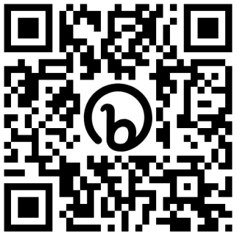
Student Chromebooks
Student Insurance/Device Protection $20 per child
Students who do not purchase insurance will be day users.
If a student is frequently coming to school without a laptop or it is uncharged, he/she may be made a day user as well.
Technology Device Agreement paper form available in the cafeteria tonight!
Student Device Protection Plan/Insurance: Scan here to access School Cash Online and purchase
Notes:
Knox County Board Policy: The technology devices are property of Knox County Schools. The student will be responsible for any damage to the technology device, charger, or protective covering. The student will be charged for any needed repairs, not to exceed the replacement cost of the technology device.
Any student that exceeds $100 in damages will become a day user.

Slide 23
Parents: Help Us
Please make sure your child gets adequate sleep
Energy drinks are not a solution
What students eat in the morning has significant impact on their day
Please do not text your child and expect a response during classes
Attendance is critical.
In loco parentis
Employees of SDMS are charged by the parents of the students to act on their behalf while the students are here and we take this responsibility very seriously.
We value the trust you give us when you drop off your child at SDMS.

Slide 24
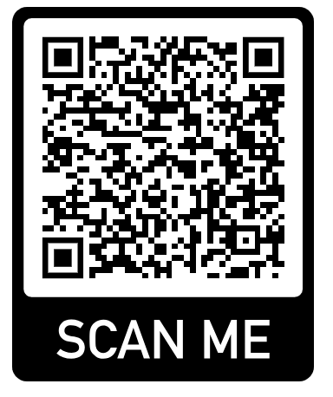
Volunteer for PTSO!
We are always in need of volunteers for PTSO
Scan the QR code below to register your interest in serving as a:
Member
Officer
Volunteer for specific events

Slide 25
A Message to Our 6th Graders
You are important here.
You will grow here.
Don’t compare yourself to anyone else. Compare yourself today to who you were yesterday.

Slide 26
Upcoming Dates
6th Grade Orientation Day
Earlier this morning!
First Day of School
Thursday, August 8th
8:30-12:00 (Half Day)
Early Release
Wednesday, August 14th
Dismissal at 1:30 PM
Open House
Thursday, August 22nd
5:30-7:15 PM

